Slide 1
Explainable AI with Shapley Values

Slide 2
Why was I denied?
chance John will have repayment problems
Accuracy = $
model
22%
No loan
What is our
financial risk?
How do I
debug?
John, a bank customer
Notes:
We'll start with a simple motivational example. This is John, a typical bank customer. Like many consumers today, when he applies for a loan, information about him is sent through a predictive model XX.
This model is designed to calculate the risk that John will have repayment problems, XX which, unfortunately for John, is 55%. And because his risk is high, the bank declines his loan application XX.
A natural first question John has XX is “Why?” The bank XX also want to know why, because these are key business decisions. But unfortunately for the data scientist that built this model XX, she used a complex model and so these questions are hard to answer XX …. XX

Slide 3
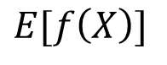

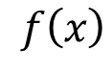
Base rate
Prediction for John
16%
22%
$$0$$
$$E[f\left(X\right)]$$
$$f\left(x\right)$$
How did we get here?
Notes:
To see, let’s return to John and answer why his loan application was denied. To explain his denial it is important to start with the base rate of loan repayment problems XX, denoted here by the expected value of the model’s output.
To explain John's risk XX, we need to explain how we got from the base rate XX, to his risk of 55%. XX

Slide 4
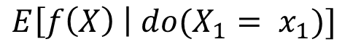
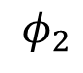
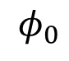
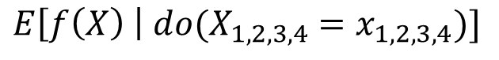
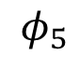
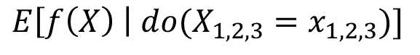
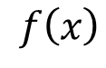
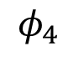
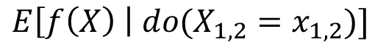
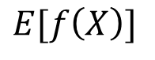
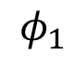
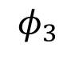
The order matters!
16%
18.2%
18.5%
21%
22%
22.5%
$$E[f\left(X\right)]$$
*
$$E\left[f\left(X\right) \right| {do(X}_{1,2,3}=x_{1,2,3})]$$
$$f\left(x\right)$$
$$E\left[f\left(X\right) \right| do(X_{1}= x_{1})]$$
$$E\left[f\left(X\right) \right| do(X_{1,2}=x_{1,2})]$$
$$0$$
$$E\left[f\left(X\right) \right| do(X_{1,2,3,4}=x_{1,2,3,4})]$$
$$φ_{0}$$
$$φ_{2}$$
$$φ_{1}$$
$$φ_{4}$$
$$φ_{3}$$
Base rate
DTI = 30
Income not verified
Delinquent 10 months ago
No recent account openings
$$φ_{5}$$
*Janzing et al. 2019
46 years of credit history
Notes:
To see, let’s return to John and answer why his loan application was denied. To explain his denial it is important to start with the base rate of loan repayment problems XX, denoted here by the expected value of the model’s output.
To explain John's risk XX, we need to explain how we got from the base rate XX, to his risk of 55%. XX

Slide 5
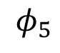
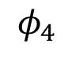
Lloyd Shapley
The order matters!
Nobel Prize in 2012
$$0$$
$$E[f\left(X\right)]$$
$$f\left(x\right)$$
$$φ_{0}$$
$$φ_{2}$$
$$φ_{1}$$
$$φ_{3}$$
$$φ_{5}$$
46 years of credit history
$$φ_{4}$$
No recent account openings
Notes:
To see, let’s return to John and answer why his loan application was denied. To explain his denial it is important to start with the base rate of loan repayment problems XX, denoted here by the expected value of the model’s output.
To explain John's risk XX, we need to explain how we got from the base rate XX, to his risk of 55%. XX

Slide 6
Shapley values result from averaging over all N! possible orderings.
(NP-hard)
$$0$$
$$E[f\left(X\right)]$$
$$f\left(x\right)$$
$$φ_{0}$$
$$φ_{2}$$
$$φ_{1}$$
$$φ_{3}$$
$$φ_{5}$$
$$φ_{4}$$
Notes:
To see, let’s return to John and answer why his loan application was denied. To explain his denial it is important to start with the base rate of loan repayment problems XX, denoted here by the expected value of the model’s output.
To explain John's risk XX, we need to explain how we got from the base rate XX, to his risk of 55%. XX

